Slide 1
Week 19: More Inheritance
Getting the most from inheritance.

Slide 2
Java
We have now covered the "core" of Java.
We have three remaining things to do:
Explore the (vast) library of classes available in Java.
Explore ways to develop more sophisticated object interactions.
Discuss Methodology and structured programming
Remember that the "trick" in programming is to spot patterns.

Slide 3
Assessment
Last tutorial you added inheritance to your BankAccount classes.
The new solution is much better, but not perfect.
We need to untangle how the two subclasses may have different display methods.
Trying to do so will also highlight other issues, which we will now try to sort out.

Slide 4
Inheritance …
So far we have seen that inheritance:
Helps with avoiding code duplication.
Promotes code reuse.
Potentially allows for easier maintenance (DRY).
Makes applications easier to extend.
We can also see the important of class diagrams?

Slide 5
DRY Programming
A very important programming principle is DRY:
"Don't Repeat Yourself"
Usually stated as:
"Every piece of knowledge must have a single, unambiguous, authoritative representation within a system."
i.e., don’t have two things doing the same thing.

Slide 6
DRY Programming
Why DRY?
Do it once, and the chances are it will be correct.
Worst case, if it's wrong, you only have to fix it in one place.
It applies all across Computing, especially in networks, databases, and programming so it’s very useful to learn!

Slide 7
DRY Programming
Compare this with WET:
Write Everything Twice.
We Enjoy Typing.
Waste Everyone's Time.

Slide 8
Maximise Work
Yet another important principle:
"Maximise the amount of work not done."
Reuse code.
Spot patterns.
Be DRY.
Design with change in mind.
Be "Agile".

Slide 9
Desired Traits
In my opinion, a good programmer is one who wants to do the maximum amount of high quality work with the minimum of effort.
This doesn't mean a programmer can be lazy, more that a programmer should have the desire to be efficient with their time and effort whilst maintaining high standards!

Slide 10
More Inheritance
Today we extend our knowledge of inheritance by looking at:
Subtyping.
Substitution.
Polymorphic variables.
Casting.
toString in inheritance.

Slide 11
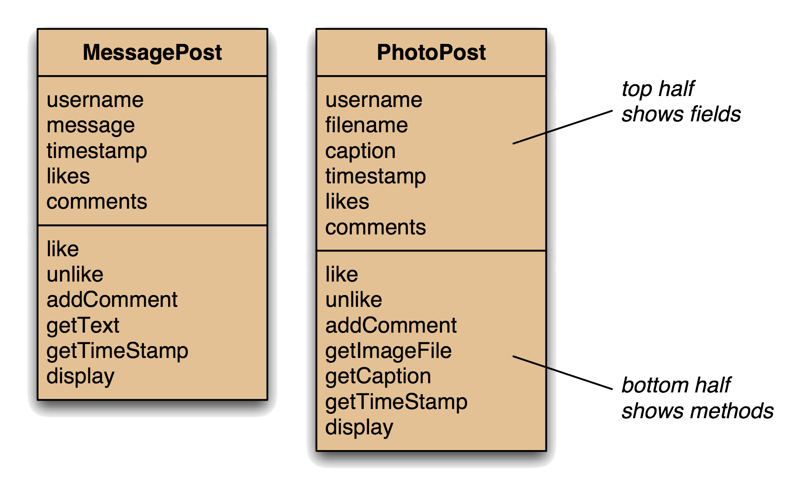
Network Classes

Slide 12
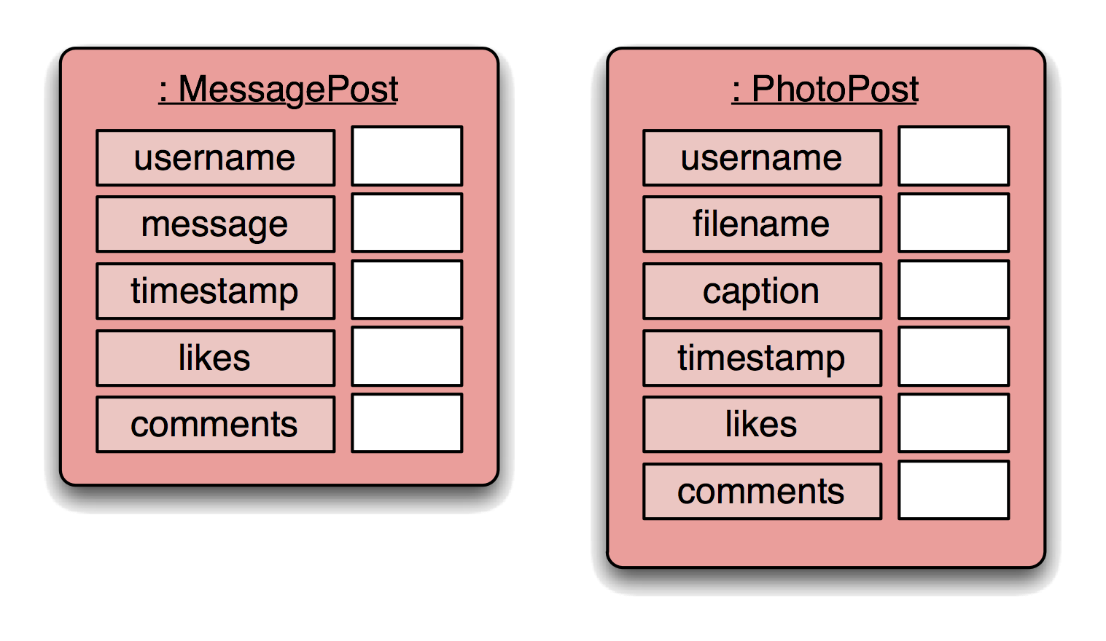
Network Objects

Slide 13
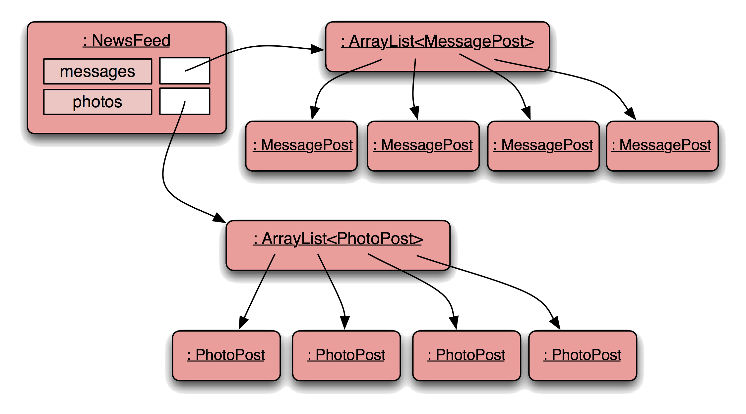
Network Object Model

Slide 14
Network Object Model
Why this is bad?...
Each new type of message will need a new ArrayList, an add method to add items to it, a change to the constructor and a change to the print method.
This is soaking WET!

Slide 15
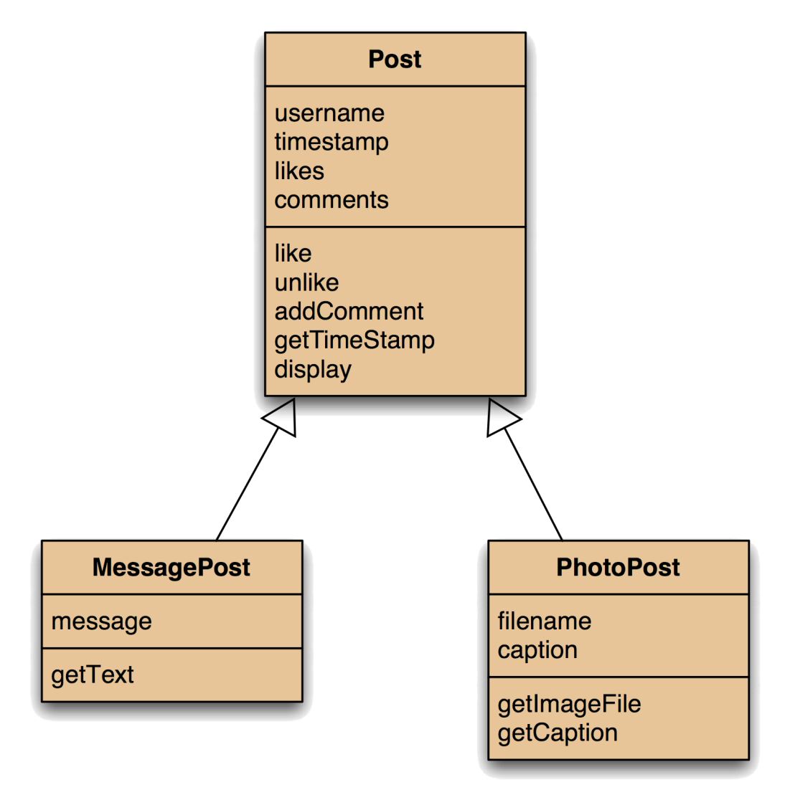
Using Inheritance

Slide 16

Using Inheritance

Slide 17
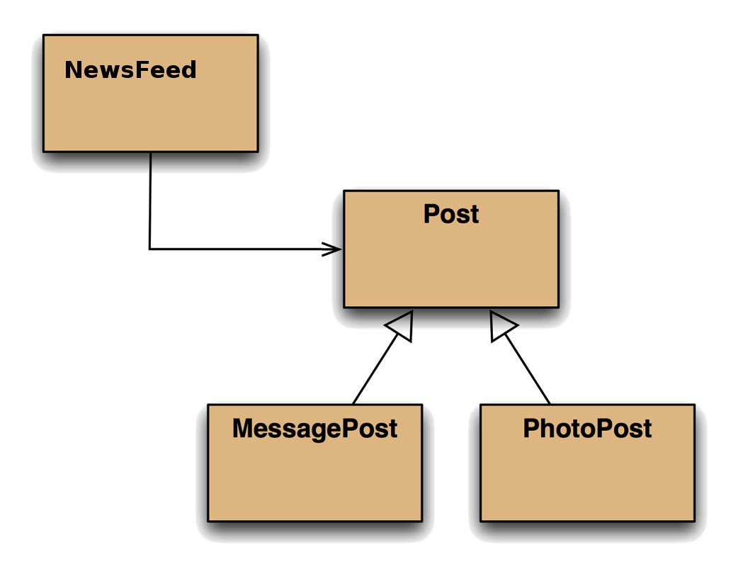
Class Diagram

Slide 18
Class Diagram
Note that NewsFeed is only aware of Post: it knows nothing of MessagePost and PhotoPost.

Slide 19
Class Diagram
If NewsFeed encounters a display method call it will look for it in Post: it cannot look lower down because it knows nothing of MessagePost and PhotoPost.

Slide 20
Class Diagram
Likewise MessagePost and PhotoPost have no idea they are being used in a NewsFeed.

Slide 21
Class Diagram
And Post is totally oblivious of the fact that there are other classes inheriting from it.
All these things are, of course, exactly what we want.

Slide 22
Class Diagram
We noted last time that there is, in fact, no such thing as a Post.
To be formal, it's an abstract class.
In practical terms, this just means that we can't create an instance of the class (only its subclasses).

Slide 23
Class Diagram
We see that we can add new types of Post without changing any of the existing classes.
Any new child class just needs to extend (inherit from) our Post class.

Slide 24
NewsFeed
NewsFeed deals only in Post objects.
It is totally unaware that there are different child classes.
Our ArrayList contains ‘Post’ items only.
As Post is an abstract class, these must be one of the child types!
public class NewsFeed
{
private ArrayList <Post> posts;
public NewsFeed ()
{
posts = new ArrayList <Post> ();
}
public void addPost (Post newPost)
{
posts.add (newPost);
}
}

Slide 25
NewsFeed
However, the Post object used here as a parameter could be a MessagePost or a PhotoPost.
And, as we know, it could never be an actual Post object.
public class NewsFeed
{
private ArrayList <Post> posts;
public NewsFeed ()
{
posts = new ArrayList <Post> ();
}
public void addPost (Post newPost)
{
posts.add (newPost);
}
}

Slide 26
NewsFeed
However, the Post object used here as a parameter could be a MessagePost or a PhotoPost.
Something clever is clearly going on here, but what?
public class NewsFeed
{
private ArrayList <Post> posts;
public NewsFeed ()
{
posts = new ArrayList <Post> ();
}
public void addPost (Post newPost)
{
posts.add (newPost);
}
}

Slide 27
NewsFeed
This loop works through all the Post objects.
Some will be MessagePost and some will be PhotoPost, which will (ideally) be displayed in different ways.
public void show ()
{
for (Post p: posts) {
p.display ();
System.out.println ();
}
}

Slide 28
NewsFeed
This loop works through all the Post objects.
Some will be MessagePost and some will be PhotoPost, which will (ideally) be displayed in different ways.
public void show ()
{
for (Post p: posts) {
p.display ();
System.out.println ();
}
}

Slide 29
Adding a Post
In the beginning there were two methods to add posts to the feed.
public void addMessagePost (MessagePost m)
public void addPhotoPost (PhotoPost p)

Slide 30
Adding a Post
These have now gone, replaced with a single method that accepts the type Post and add’s (children of) post instances to our single ArrayList
public void addMessagePost (MessagePost m)
public void addPhotoPost (PhotoPost p)
public void addPost (Post p)

Slide 31
Adding a Post
And this new method works with either MessagePost or PhotoPost.
public void addMessagePost (MessagePost m)
public void addPhotoPost (PhotoPost p)
public void addPost (Post p)
PhotoPost p = new PhotoPost (...);
feed.add (p);
MessagePost m = new MessagePost (...);
feed.add (m);

Slide 32
Subclasses and Subtyping
So:
Classes define types. (Parent)
Subclasses define subtypes. (Child)
Objects of subclasses can be used wherever objects of their superclasses are required.
This is called substitution.

Slide 33
Adding a Post
This is substitution. The code uses subclass objects (PhotoPost or MessagePost) where the parameter declares that a supertype object (Post) is required.
As the child classes extend Post, Java knows that they can be added to the Arraylist containing Post instances.
public void addMessagePost (MessagePost m)
public void addPhotoPost (PhotoPost p)
public void addPost (Post p)
PhotoPost p = new PhotoPost (...);
feed.add (p);
MessagePost m = new MessagePost (...);
feed.add (m);

Slide 34
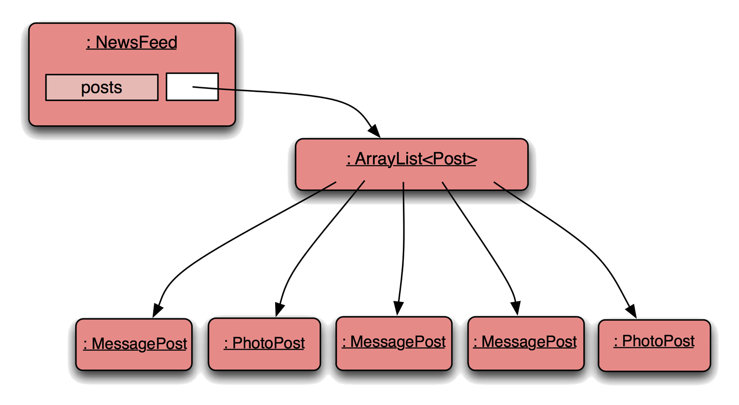
New Network Object Model

Slide 35
Working with Types
Subclass objects may be assigned to superclass
variables.
Post p2 = new MessagePost (...);
Post p3 = new PhotoPost (...);
These can all be used wherever the superclass is required.

Slide 36
Polymorphic Variables
Object variables in Java are polymorphic.
This means they can hold objects of more than one type:
The originally declared type.
Any subtype of the declared type.
So it would be possible to declare a Post, and later turn it into a MessagePost, and later into a PhotoPost.
We have seen this before with List and ArrayList.

Slide 37
Casting
We can assign subtype to supertype …
… but not the other way round.
Post p;
PhotoPost pp = new PhotoPost (...);
p = pp; // Fine.
pp = p; // Compile-time error.

Slide 38
Casting
If this is necessary, and p really is a PhotoPost, then casting fixes it:
pp = (PhotoPost) p;
We can assign subtype to supertype …
… but not the other way round.
Post p;
PhotoPost pp = new PhotoPost (...);
p = pp; // Fine.
pp = p; // Compile-time error.

Slide 39
Casting
The required object type is specified in brackets.
The object is not changed in any way.
A runtime check is made to ensure that the object really is of that type (an exception is thrown if not).
Use sparingly. But sometimes it is essential so as to avoid very ugly code.

Slide 40
Using Inheritance

Slide 41
Using Inheritance
Our problem is that both MessagePost and PhotoPost have a display method, but at present it is the same method.

Slide 42
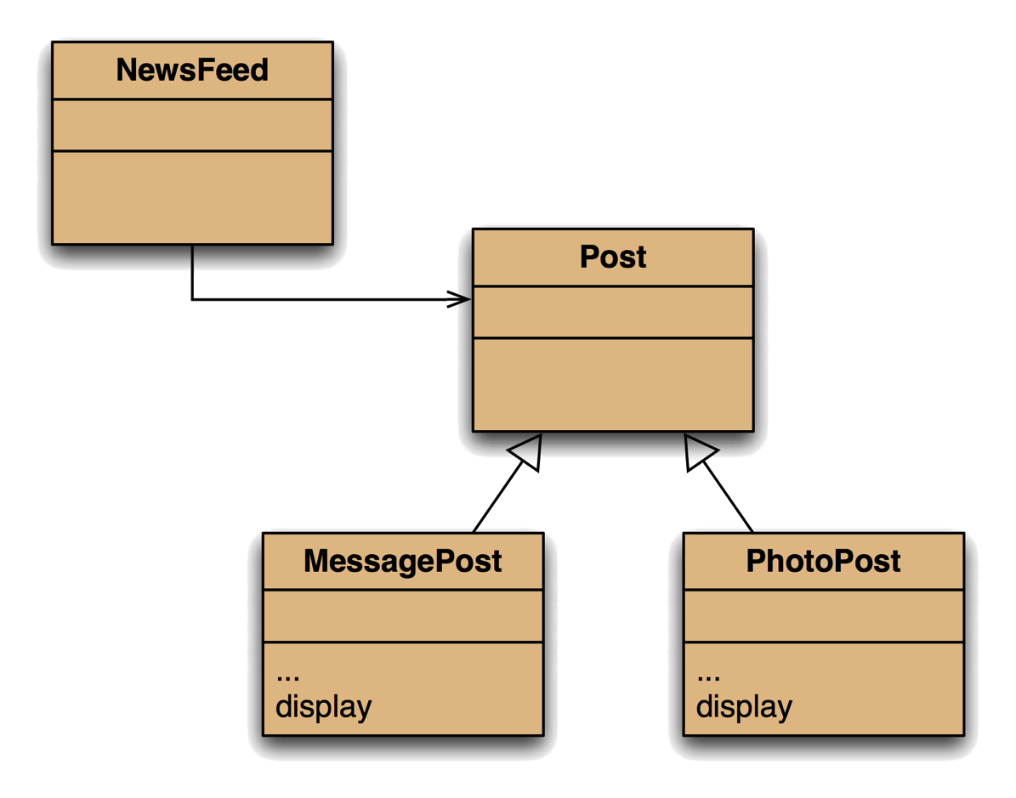
Using Inheritance
An obvious solution is to move the display methods into the subclasses, like this.

Slide 43
Using Inheritance
Unfortunately, this breaks the NewsFeed code because it deals only in Post objects, which no longer have a display method.

Slide 44
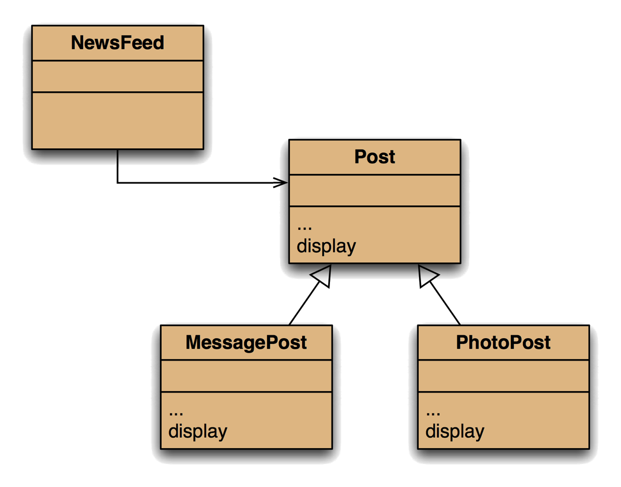
Using Inheritance
So, this is a solution that will work.
Post has a display method, which we override in the subclasses.

Slide 45
Super
If needed, the subclasses can call any method in the superclass using a super call.

Slide 46
Super
Generic Display Method
What we have here is an example of overriding (which we will look at properly next time).
Specialist Display Method

Slide 47
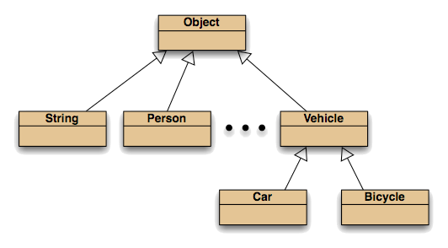
Overriding
But we have been using this idea all along.
All classes inherit (eventually) from Object.
Object defines (among a few other things), toString.

